Slide 1
Switching Behavior of Izhikevich Model
Yoon JaeHong, Zhongxi Li
2017 November

Slide 2
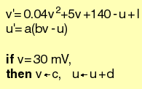
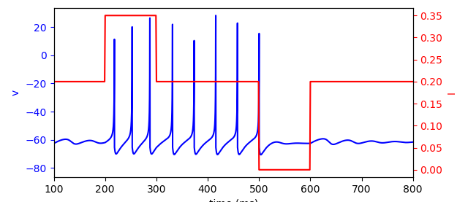
Goal
Find and explain a set of parameters such that one Izhikevich-type neuron can exhibit switching (or memory) behavior.
Izhikevich model
Switching behavior
Turn on
Turn off

Slide 3
Motivation and Challenges
Motivation:
We believe biological working memory can be carried out by a single neuron with a clean mathematical interpretation.
Challenges:
The Izhikevich model is defined in a hybrid manner. The conditions make the model discontinuous.

Slide 4
Motivation and Challenges
Genetic algorithm → parameter set (a, b)
Izhikevich model
Define switching behavior
Explanation
Nonlinear dynamics analysis

Slide 5
Observation
2
1
3
4
5
1
2
3
4
5
saddle point
saddle point
saddle point
saddle point
saddle point
stable spirals
unstable spirals
stable spirals
stable spirals
stable spirals
Observation: the switching behavior is associated to a Hopf-bifurcation

Slide 6
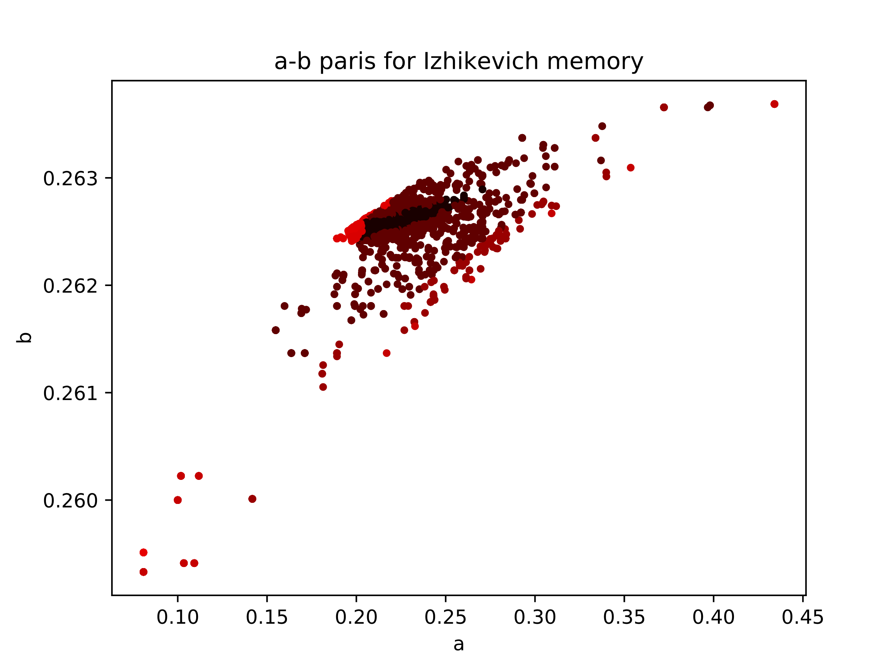
I = 0.2
I = 0.4

